Slide 1
Charlotte D’Hulst, PhD
Co-Founder & CEO
www.mousensor.com
Proud winner of the
Outstanding Pitch Award at
New York BIO 2017
Notes:
Hi,
I am Charlotte D’Hulst, CEO and Co-Founder of MouSensor, LLC.
We are an early stage biotech startup that engineers super sniffer mice to build a human-nose-on-a-chip.
We have the bold vision to detect, discover and digitize all odors on this planet. Ranging from the fragrances in a perfumer’s palette to the Chardonnay in your wine cellar.

Slide 2
Problem
$150B Industry
Fragrance Discovery Today
Trial & Error
NO rational design
NO quantitative assay
NO automation
Every aspect of our daily lives
$1.5B
2/1000
?
Highly Inefficient
Notes:
The industry behind Fragrance is globally worth over $150B every year.
The fragrance and flavors created by the big Fragrance Houses are incorporated into every aspect of our daily lives from fine perfumes to beauty, detergent and household products.
Yet, Fragrance Discovery today is highly inefficient. It is mostly based on trial and error, there is no rational design, no quantitative assay, no automation. The big players spend more than $1.5B per year on their R&D, relying on the subjective opinions of highly trained research perfumers and flavorists, and only 2/1000 synthesized compounds make it to market per year.
The main problem is that human olfaction is a Black box.

Slide 3
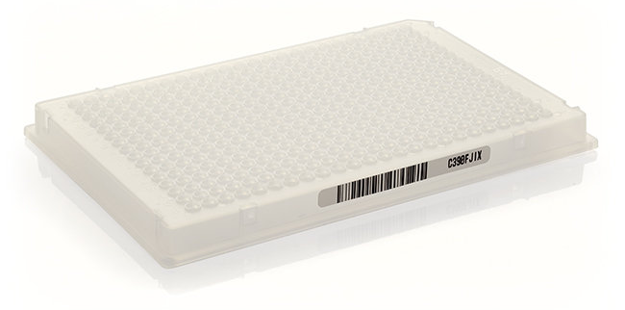
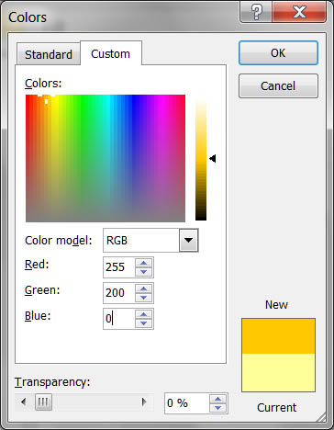
Solution
The Platform
DECODE
Human Olfaction
Human
nose-on-a-chip
Digital database
of scent
Every aspect of our daily lives
VALUE PROPOSITION
To predict “smell” of odor mixtures
To engineer new fragrances in a rational and targeted way
DECREASING R&D pipeline
with more than 80%
Compare to
SBIR
Phase I
RGB for Vision
Streamlined Pipeline
Notes:
The MouSensor Platform allows us to engineer mice that produce large amounts of human odors sensors, put them on a chip to mimic the human nose and decode human olfaction.
Our digital database of scent can be compared to the RGB code for vision and can be used by our customers to to predict SMELLS and engineer odors in a STREAMLINED and TARGETED way, DECREASING THEIR PIPELINE COST WITH MORE THAN 80%. Which gives them an enormous competitive advantage.

Slide 4
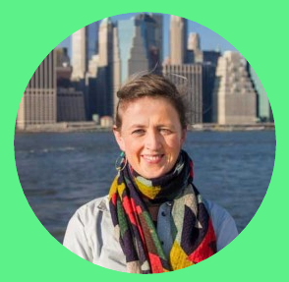
Super Sniffer Team
Charlotte D’Hulst, PhD
Co-Founder::CEO
Biomedical Engineer, CUNY
Co-developer of the Platform
Paul Feinstein, PhD
Co-Founder::CSO
Associate Professor, CUNY
>25 years experience in olfaction
Scientist, PhD
Molecular Biology
Full Time
HIRING
Fundraising
Competitive analysis
Partnerships
Market Research careers@mousensor.com
BD
Business Development
Consultant
HIRING
Notes:
Our management team exists currently out of myself, co-developer of the Platform and Paul Feinstein, our Chief Scientific Officer and tenured professor at Hunter College. He is a world expert in olfaction with more than 25 years of experience under his belt.

Slide 5
A Scalable Platform
Notes:
This last one is very important since our platform is scalable and can be applied to many different industries beyond Flavor and Fragrance such as Pharma, food and wine and even virtual reality. We need our business development person to sniff out in which of these markets our customers live.

Slide 6
"I should think we might fairly gauge the future of biological science, centuries ahead, by estimating the time it will take to reach a complete, comprehensive understanding of odor. It …. contains, piece by piece, all the mysteries.”
Lewis Thomas - 1985 - A Long Life of Cells: Collected Assays
Charlotte D’Hulst, PhD
charlotte@mousensor.com

