Slide 1
Objective Pain
Measurement
“ If you can’t measure it,
you can’t improve it ”
Lord Kelvin
Frank A. Minella
Founder & CEO
fminella@painqx.com
610.348.9153
www.painqx.com

Slide 2
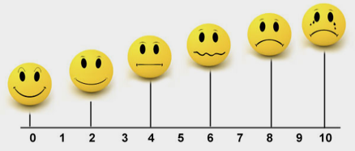
Problem: Subjective Pain Measurement
Patient Self-Report
Inadequate Current Standard of Care
Relies on patient self report
Not verifiable or replicable
Patients struggle to differentiate pain mid scale (3 to 7)
Unreliable for pain base-line or follow up

Slide 3
Problem for Clinicians: Over/Under Treatment of Patients
Result
Over-treatment
Adverse Affects
(e.g. Addiction)
Issue
Creates
Leads to
Subjective Pain Measurement
Incomplete Understanding of Patient’s Pain
(Baseline & Follow up)
Uncertainty in
Dosing
& Treatment
Under-treatment
Unnecessary Pain and Suffering
Source: Hospital & Physician Survey, Mass General Hospital Consultants, 2016

Slide 4
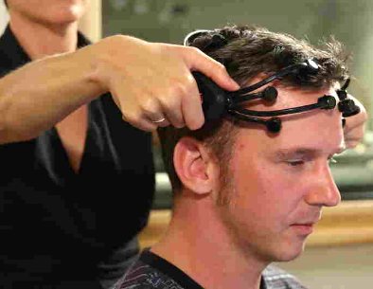
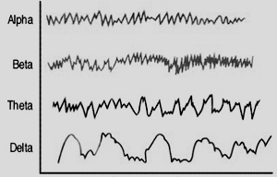
Solution Objective Pain Measurement
PainQx Neuro-analytic SaaS Platform
1
2
3
Cloud Based
Analysis / Neural Processing
$$
Time Per Patient | Under 5 Minutes
Cost | $65 per assessment
Processing Time | Real-time
Hardware | Off-the-shelf EEG Headset
Pain
Score 6.0

Slide 5
Clinical & Software Development Plan
Month:
6
12
18
24
30
CLINICAL DEVELOPMENT | Refine MVP (N=100) | Algorithm Optimization (N=200) | FDA Validation Study (N=400) | FDA Filing | FDA Review
R&D COSTS | $178,250 |  |  | $1,896,000 | $105,000
SOFTWARE DEVELOPMENT | Artifact Automation | Forehead System (Improve Clinical Utility) |  | Commercial Launch Preparation
R&D COSTS | $330,000 |  |  | $960,000
INVESTMENT | $1,000,000 |  |  | $7,000,000
Notes:
PainQx has 2 sponsored studies that will be completed in 6 months
PainQx has already completed the recruitment of 100 patients
Total additional patients required for development & FDA Clearance N=700
Total Development cost $8M
= Value Inflection

Slide 6
The Team → Mission Focused, Execution Driven
Frank A. Minella
Founder, CEO
Leslie Prichep PhD. Founder, Inventor
William Koppes MSEE.
VP of R&D
Alex Ruckdaeschel
Founder, CFO
Alejandro Zamorano VP of BD
Serial Entrepreneur
Business Management Consultant: Accenture Pharma Industry Group
28 yrs. experience in Commercial Business Management & Military Command Leadership
U.S. Army Officer and Aviator
Founder, Brain Research Lab NYU School of Medicine
Serial entrepreneur, whose patents have been successfully commercialized 3 times
Professor of Psychiatry, NYU Medical School
Neuroscience world leader, expert in QEEG
35 yrs. experience Medical Device Product Development, Implementation
VP, Global R&D Siemens Healthcare
VP, Global Engineering
Siemens Healthcare
CTO, Director of R&D BrainScope
20 yrs. experience Business Financial Management worldwide
Partner of Alpha Plus Advisors, LLC.
Co-Founder and Principal of Blue Rock - AG, Investment Advisor, Nanostart
Founder of Life Science Nation
Employee 6 at Abpro Inc.
8 yrs. experience in the business development and start up experience specific to Life Sciences
Notes:
Add bullet bios

Slide 7
Team Positions Needed
Signal Processing Engineer
Development of algorithms for objective assessment of pain based on EEG waveforms.
Responsible for artifact detection algorithm development for identifying and flagging artifacts in EEG waveforms
Development of EEG feature selection strategies, feature formulations, regression equations, discriminant functions, and performance metrics in support of algorithm development / optimization.
Statistical analysis of clinical data
Database Manager
Maintain a relational database containing study data.
Set up initial structure of the database and maintain it as new QEEG features are defined and derived.
Assist in the selection of the appropriate database technology for the PQx SaaS.
Archive the database on a regular basis and perform data integrity checks as appropriate.
Develop programs to query the database.

Slide 8
Team Positions Needed
Clinical Study Manager
Oversee data acquisition and entry at multiple research sites following study protocols.
Work with PQx Database Mgr. and development personnel to ensure that data is efficiently transferred and meets data integrity/quality.
Responsible for feedback to clinical sites on data quality and completion of electronic data capture forms (eCRFs).
Assist in identifying qualified sites for study participation.
Track key study metrics using tracking tools.
Implement Data Verification Monitoring Plans.
EEG Technologist
Acquire EEG data using International 10/20 electrode placement system.
Extract EEG information from EDF files.
Artifact identification in raw EEG recordings.
Clinical and electrophysiological data acquisition, database entry and querying.
Utilize data analysis programs, such as EEG source localization.

